Slide 1
Training Presentation on
Governance, Risk, and Compliance
Name of the Presenter:
Date:

Slide 2

Topics Covered
Agenda
Introduction to Governance, Risk & Compliance
Compliance Frameworks
Introduction to Sox
SOX in GE
GE Capital Americas - ITCF

Slide 3
Introduction to Governance, Risk & Compliance

Slide 4
Governance, Risk & Compliance
Governance, risk management, and compliance or GRC is the umbrella term covering an organization's approach across these three areas.
GRC typically encompasses activities such as corporate governance, enterprise risk management (ERM) and corporate compliance with applicable laws and regulations.
Governance describes the overall management approach through which senior executives direct and control the entire organization, using a combination of management information and hierarchical management control structures. It ensures that critical management information reaching the executive team is sufficiently complete, accurate and that strategies, directions and instructions from management are carried out systematically and effectively.
It is a mechanism put in place to ensure compliance with those rules and regulations under which an IT department functions.
It’s about how organizations align IT strategy with business strategy, ensuring that companies stay on track to achieve their strategies and goals, and implementing good ways to measure IT’s performance.
IT Governance would determine how the IT department is functioning overall, what key metrics management needs and what return IT is giving back to the business on investment.
What is IT Governance?

Slide 5
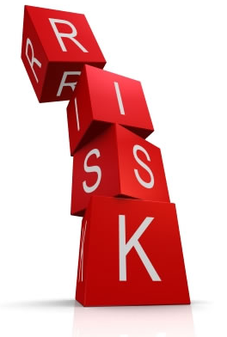
Risk Management
Definition of Risk Management?
The process of identification, analysis and either acceptance or mitigation of uncertainty in investment decision-making is defined as Risk Management.
Essentially, it’s the analysis to quantify the potential impact for losses and then the appropriate action (or inaction) given their investment objectives and risk tolerance. Inadequate risk management can result in severe consequences for companies as well as individuals.
For example, the recession that began in 2008 was largely caused by the loose credit risk management of financial firms.
Simply put, risk management is a two-step process - determining what risks exist in an investment and then handling those risks in a way best-suited to your investment objectives.

Slide 6
Risk Management
IT Risk Management (ITRM)
Many people assume that IT Risk Management is really about IT security. This is a misconception. IT security risk management is one particular variant of ITRM, and so is software security risk management.
Business and IT have long enjoyed a love-hate relationship. Business is as old as the market and is about buying and selling and coming out ahead. Information technology is as recent as the semiconductor and is about accelerating all sorts of processes - including business processes - through automation.
Business has now understood the essence of capitalizing on the process improvements made possible by IT, in order to drive market efficiencies and create competitive advantages that lead to greater profits.
Therefore, IT Risk Management is about Identifying every Risk associated to the Business IT Service, and appropriately & reliably quantifying the cost of risk and the true cost of remediating a risk.

Slide 7
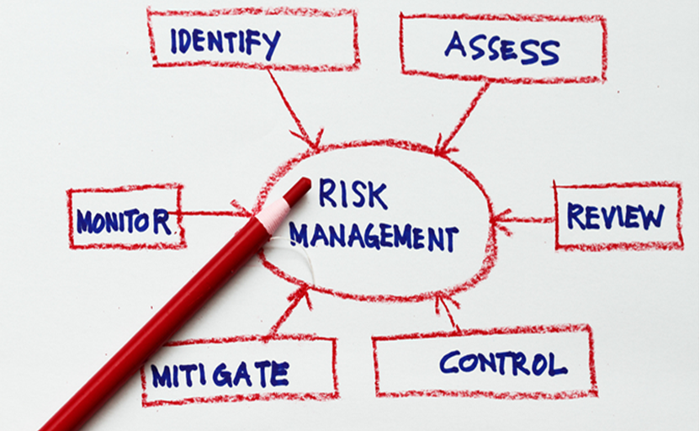
Risk Management
Simple Pictorial Representation of Risk Management

Slide 8
Compliance
What is Compliance?
In general, compliance means conforming to a rule, such as a specification, policy, standard or law.
Therefore, the term compliance describes the ability to act according to an order, set of rules or request. Businesses compliance operates at two levels.
Level 1 - compliance with the external rules that are imposed upon an organization as a whole
Level 2 - compliance with internal systems of control that are imposed to achieve compliance with the externally imposed rules
Key functions of Compliance
Advisory
Identification
Prevention
Monitoring & Detection
Resolution
Identify the risks that an organization faces
Design and implement controls to protect an organization from those risks
Monitor and report on the effectiveness of those controls in the management of an organization's exposure to risks
Resolve compliance difficulties as they occur
Advise the business on rules and controls

Slide 9
Regulatory Compliance
What is Regulatory Compliance?
Regulatory compliance is the organization's adherence to laws, regulations, guidelines and specifications relevant to its business. Violations of regulatory compliance regulations often result in legal punishment, including federal fines.
Regulatory compliance describes the goal that corporations or public agencies aspire to achieve in their efforts to ensure that personnel are aware of and take steps to comply with relevant laws and regulations.
Regulatory compliance can take on different definitions according to the industry in which you are applying the policies. Since compliance means incorporating standards that conform to specific requirements, regulatory compliance is the regulations a company must follow to meet specific requirements.
Globalization has evoked increase number of regulations and need for Operational transparency that Organizations are today implementing various standards, controls to be compliant.
Examples of regulatory compliance laws and regulations include the
Payment Card Industry Data Security Standard (PCI DSS)
Health Insurance Portability and Accountability Act (HIPAA)
Federal Information Security Management Act (FISMA)
Sarbanes-Oxley Act (SOX)

Slide 10
Regulatory Compliance
IT Regulatory Compliance
When you apply Regulatory Compliance to IT, the regulations apply to two different aspects of company operations which include the internal requirements for IT and compliance standards that are set forth by external entities.
Both types of regulatory compliance affect IT company operations and can potentially restrict what a company can and cannot do.
Company Concerns with Regulatory Compliance
When it comes to information technology and security, regulatory compliance for IT can impose added costs on company operations depending upon the industry. At the same token, the cost of not complying with regulations both internally and externally can be significantly higher in terms of fines and time invested following up on a security breach
The primary issues with regulatory compliance is
Information security
And the potential for data leaks
Additionally, there are many benefits that come with following regulatory compliance policies which include protection of company reputation.

Slide 11
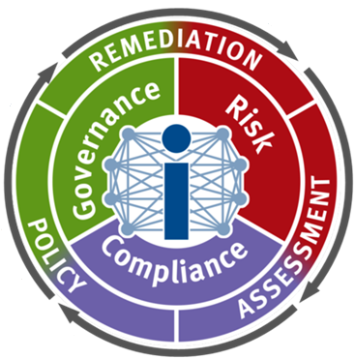
Governance, Risk & Compliance
Widespread interest in GRC was sparked by the US Sarbanes-Oxley Act and the need for US listed companies to design and implement suitable governance controls for SOX compliance, but the focus of GRC has since shifted towards adding business value through improving operational decision making and strategic planning.
It therefore has relevance beyond the SOX world.
Governance, risk, and compliance or GRC are increasingly recognized terms that reflects a new way in which organizations are adopting an integrated approach to these aspects of their business.

Slide 12
Compliance Frameworks

Slide 13
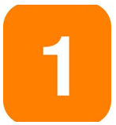


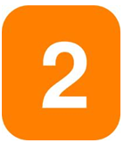
Types of Compliance Framework
There are 2 types of compliance framework that are widely followed. They are,
GE Capital Americas IT Controllership framework for SOX, Banking and Covered Data is formulated using the COBIT framework

Slide 14
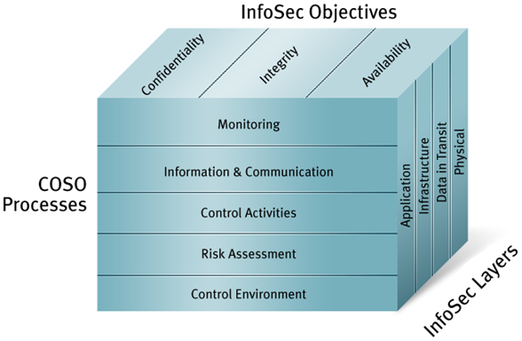
COSO Framework
What is COSO?
COSO (Committee of Sponsoring Organizations of the Treadway Commission) is a joint initiative of five private sector organizations, established in the United States, dedicated to providing thought leadership to executive management and governance entities on critical aspects of organizational governance, business ethics, internal control, enterprise risk management, fraud, and financial reporting.
The COSO Cube
COSO framework contains five control components needed to help assure sound business objectives. The control components are:
Control Environment.
Risk Assessment.
Control Activities.
Information and Communication.
Monitoring.
More specifically, the thought process behind these five components was that they would work together to support efforts to achieve an organization's mission, strategies and related business objectives. All five components would need to be in place to achieve an "effective" internal control system.

Slide 15
COBIT Framework
What is COBIT?
COBIT (Control Objectives for Information and related Technology) is an IT Governance framework that provides governance (entity-level) and detailed (activity-level) objectives. Established in 1996 by ISACA and the IT Governance Institute (ITGI), COBIT is the result of industry-wide consensus by managers, auditors, and IT users. Today, COBIT is accepted as a best-practices on IT process and control framework.
To ensure that IT is aligned with business objectives, the COBIT controls framework of four domains and 34 processes is an industry-wide standard.
The four domains are:
Plan and Organize
Acquire and Implement
Deliver and Support
Monitor and Evaluate
COBIT contains more than 200 detailed control objectives to support these domains and processes.
COBIT 5 is the latest edition of ISACA’s globally accepted framework

Slide 16
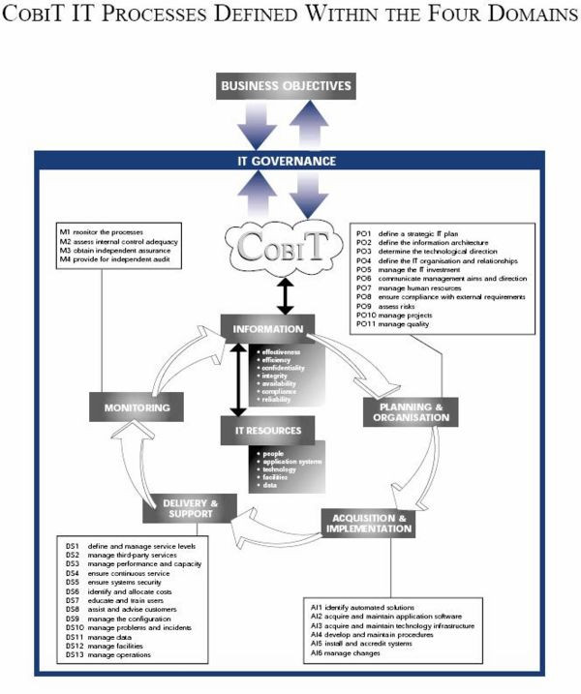
COBIT Framework

Slide 17
COBIT Framework
Overview on COBIT 5
COBIT 5 is the only business framework for the governance and management of enterprise IT. This evolutionary version incorporates the latest thinking in enterprise governance and management techniques, and provides globally accepted principles, practices, analytical tools and models to help increase the trust in, and value from, information systems. COBIT 5 builds and expands on COBIT 4.1 by integrating other major frameworks, standards and resources, including ISACA’s Val IT and Risk IT, Information Technology Infrastructure Library (ITIL®) and related standards from the International Organization for Standardization (ISO).
Benefits
Maintain high-quality information to support business decisions
Achieve strategic goals and realize business benefits through the effective and innovative use of IT
Achieve operational excellence through reliable, efficient application of technology
Maintain IT-related risk at an acceptable level
Optimize the cost of IT services and technology
Support compliance with relevant laws, regulations, contractual agreements and policies

Slide 18
Sarbanes Oxley IT 404 (SOx) - Introduction

Slide 19
Why SOX?
In the Beginning
These are few examples of the scandals and the environment that led up to the public distrust of public companies and ultimately to Congress’ need to react to the publicity. This is a clear indication that management’s financial statements were not accurate and sometimes fraudulent.

Slide 20

So, what happened NEXT?

Slide 21
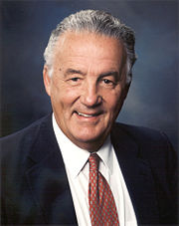

In Y2002
Two US Senators formalized the Sarbanes-Oxley Act also known as
“SOx Act”
Paul Sarbanes (MD)
Michael Oxley (OH)

Slide 22
Sarbanes-Oxley Act :
SARBANES–OXLEY ACT (SOX) was passed in 2002 after a string of high profile corporate scandals. The Securities and Exchange Commission (SEC) was put in charge of enforcing the law. To protect investors by improving the accuracy and reliability of corporate disclosures made pursuant to the securities laws, and for other purposes. The SEC oversees the compliance by publicly traded companies to the Act. The Public Companies Accounting Oversight Board (PCAOB) drives the compliance.
What did the Act do?
The Sarbanes-Oxley Act created new standards for corporate accountability as well as new penalties for acts of wrongdoing.
The Sarbanes-Oxley Act is classified into 11 Titles, and 68 Sections
Sarbanes-Oxley Act established many controls and refinements over Corporate Governance
One key section is SOX Section 404, which deals with internal controls
SOX Section 404 rules require each annual report to contain an internal control report which should state the responsibility of management for establishing and maintaining an adequate internal control structure and procedures for financial reporting, and contain an assessment of the effectiveness of the internal control structure and procedures of the issuer for financial reporting.

Slide 23
SOX 404 Requirements Ensures
Client management must:
Document and test the Internal Controls over Financial Reporting (ICFR)
Issue an annual assertion on the effectiveness of ICFR
External Auditors must:
Determine nature, timing, and extent of testing
Review work performed by management
Perform some independent tests of controls
Attest and report on:
Management’s 404 assertion process
Design and effectiveness of internal controls

Slide 24
SOX Purpose
To ensure the accuracy and timeliness of financial reporting. It sought to restore public opinion and investor faith by accomplishing greater:
Transparency in corporate finance
Accountability for corporate officers
auditor independence & auditor oversight
ability to prosecute
Renewed investor confidence
Better quality, accuracy and timeliness of financial data
Operational efficiencies
Greater reliance on information technology
Reduced number of financial surprises & Business failures
Increased management responsibility & accountability
SOX Benefits

Slide 25
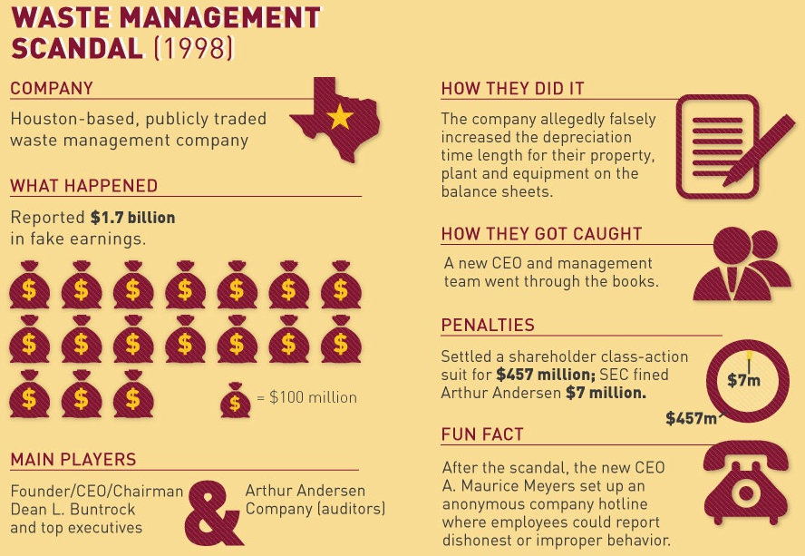
Some Corporate Scandals

Slide 26
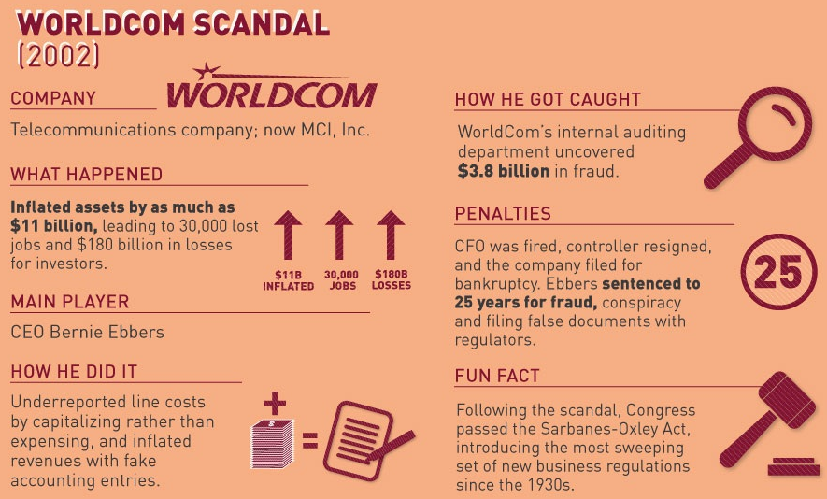
Some Corporate Scandals

Slide 27
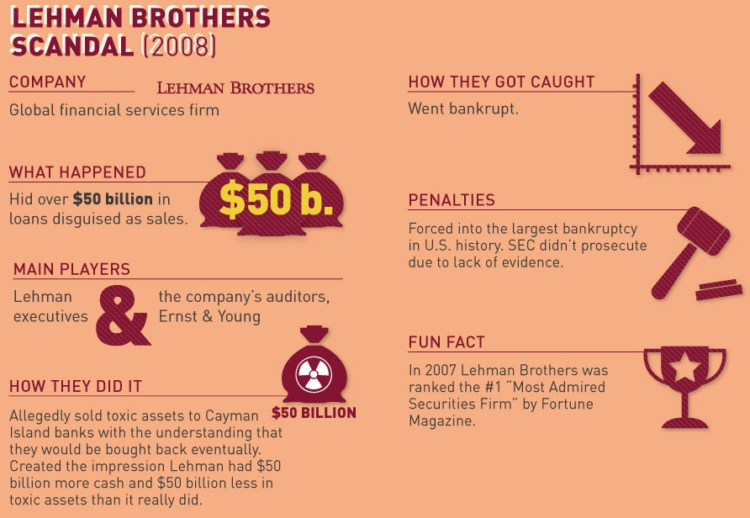
Some Corporate Scandals

Slide 28
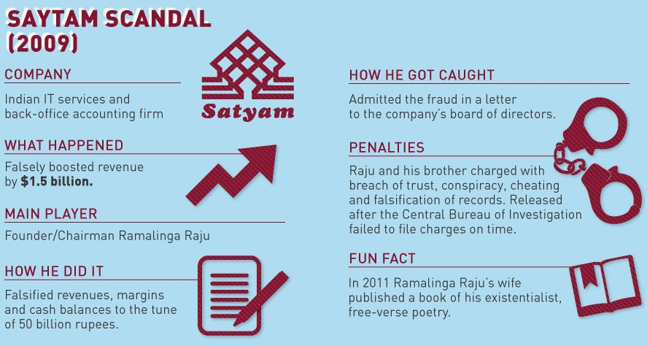
Some Corporate Scandals

Slide 29
SOX in GE

Slide 30
Controls in GE
General IT Controls (GIT)
IT process controls that ensure sustainable application controls, financial accuracy and timeliness of reporting.
Application Controls
Controls in/or between applications to enforce data integrity, business rules or manual controls.
Entity Level Controls
Controls that permeate an organization and have a significant impact on how it achieves its financial reporting and disclosure objectives.
Finance Controls
Controls focus on the integrity of data captured and/or reported through manual and key applications controls.

Slide 31
Control Areas
COBIT / Control Areas
Sample controls
1. DS4 Ensure Continuous Service
Successful DR tests performed
2. DS5 Ensure System Security
3rd party connections; account reviews
3. DS10 Manage Problems & Incidents
Tracking & resolving incidents
4. DS11 Manage Data
Backup and recovery of data
5. DS12 Manage IT Physical Space
Access rights; environmental factors
6. DS13 Manage Operations
System maintenance; vendor support
7. AI6 Manage Change
Authorization to make changes
8. PO10 Manage Program Dev
Approve & test new implementations

Slide 32
Sox Cycle
ROLL FORWARD TESTING &
REPORT TO GE CORPORATE
Complete roll forward testing
KPMG Review & Testing
Report metrics to GE Corporate
Rep Letter sign-off
SCOPE ASSESSMENT
Risk assessment
Identify Business Processes in scope
Identify and Map Applications to Business Processes
Determine Applications & related infrastructure
in SOX scope
Identify 3rd Party Providers & Shared Service Providers
Our Approach should:
Enhance Return on Investment for the Company
Make compliance low cost, efficient, repeatable & sustainable
Drive SOX 404 assessment as an ongoing process
RE-TESTING
Re-test fixed controls
Document re-test results & re-test evidence
DOCUMENTATION
Assign Control/Process Owners
Complete CIVI
Document Process Narrative
Develop Test Plan
REMEDIATION/MITIGATION
Prepare remediation/mitigation plan for the failed controls
Implement remediation/mitigation plan
TESTING
Define the systems to be tested and the sample size
Test the sample for compliance with the policy
Document test results and test evidence

Slide 33
GE Capital Americas – IT Controllership Framework (ITCF)

Slide 34
iGATE’s Roles & Responsibilities
Establish program deliverables and milestones necessary for achievement of team goals
Work closely with IT Controller to develop timetables, schedules and to make recommendations regarding documentation of controls and monitoring
Ensure all pertinent documentation is complete, is of "audit quality“ and meets their required audit objectives
Analyze all control documentation/test plans for gaps and ensure they are adequate and present an accurate depiction of process/test (ToD/ToE) through iTerm
Ensure that the relevant documents describe the nature of the control, applications/processes covered, tests to be performed, samples taken and results of the test(ToE)
Ensure that all documentation meet the requirements of KPMG
Ensure that all administrative duties like Reporting, Dashboard Management, Task Scheduling are managed effectively
Assist the organization in answering questions from statutory auditors (KPMG) towards the end of the year
Project Management to accomplish GE Corporate tollgates
Ensure Quarterly and Annual SAT review is complete and PAST due updates are published on weekly basis and contact AOs for follow ups and Ensure closure
Plan and complete Control Narratives for SOX, Bank and SPII applications by contacting AOs and upload them into iTerm for TOD. Plan and execute TOE testing for SOX and Bank applications and upload the results to iTerm. Ensure the timeline and quality is assured.
For the iTerm assessments including Real Estate Business plan and complete the TOD and TOE review before the deadline
Plan and complete the GECC Review on time and publish the metrics on a daily basis.
Prepare OCMP Monthly report and Change Management Monthly Report

Slide 35
List of Controls for GECA - ITCF
Controls in Scope for GE Capital Americas
32 SOX controls across 8 domains
Continuous Service/Disaster Recovery
System Security
Data Backup and Recovery/Manage Data
Problem and Incident Management
Manage Operations
Manage IT Physical Space
Change Control
Manage Program Development
39 GECB controls across 8 domains
17 Cover Data controls across 2 domains
Application Controls which includes Application Interface testing
Controls In-scope

Slide 36
Control Narrative
Objective:
To illustrate the entire process followed by the Application Team in relevancy to a control area. This would help determine if one or more controls are satisfied & if the Asset is compliant as per the control requirements.
iGATE’s Scope:
GECA Compliance Assurance Team (iGATE Team) to facilitate the documentation of control narratives with the Asset Owners for all the in-scope applications (Sox, Bank and Covered Data). Completed & Signed-off control narratives are used as a baseline to document the TOD. Any changes to the control narratives and supporting documents should be verified & confirmed with the Asset Owner for next year’s certification.
Stake Holders:
GECA Regulated Asset Owners
GECA IT Controller
GECA ITCF Support Team (iGATE team)
Frequency:
Control narratives are performed annually. Normally, this is performed during the 2nd quarter.

Slide 37
Control Narrative
Process description:
ALL in-scope applications for which the annual TOD has to be submitted is identified by the GECA Compliance Assurance Team (iGATE).GECA Compliance Assurance Team (iGATE) then contacts the AO or delegates of an asset. The processes for each control under scope for an application is discussed and documented for the below Control Narratives as applicable:
Access
Data Management
Infrastructure
Manage Operations
Security
Change Management
For existing Control Narratives from the previous year for an Application, the AO or Delegate is contacted to confirm if there are any change to the process and documented as appropriate. Also, the Supporting documents are collected to evidence the change.
Procedure Mapping File:

Slide 38
Control Narrative
Steps followed to document Control Narrative:
ABIR team will contact the Asset Owner to collect the information for every control narrative
Prior to documenting the control narrative, ABIR team will explain the procedure mapping file to the AO
For every procedure, the ABIR team will collect details that identifies the Procedure Owner for the control, who is responsible for executing the procedure and related procedure triggers.
For every control there are “Global process reference” section which the ABIR Team documents based on the Application platform and validated against WIKI for appropriateness
For controls handled by the Application team, the ABIR Team documents the global process reference field as “Process Not Applicable”
ALL supporting documents provided by the Asset Owner are uploaded to the Application’s root folder in library by the ABIR Team and the URL is captured in the control narrative.
If a supporting document is a one slider (i.e. table or list), it is acceptable to paste the data within the procedure itself

Slide 39
Test of Design (TOD)
Test of Design (TOD) tests the capability of a control to mitigate risk
TOD is used to perform the following:
1. Determine if a control exists
Is the control capable of preventing or detecting risk
2. Document the control as it exists
Document the AS-IS process
Document all exceptions to the general rule
3. Show that the control design addresses the risk
Describe how the control addresses the risk
TOD should provide sufficient information so an independent reader clearly understands the purpose, value and operation of the control

Slide 40
Test of Effectiveness (TOE)
Test of Effectiveness (TOE) tests the effectiveness of a control to mitigate risk
TOE is used to perform the following:
1. Test the control as it exists
Is the control effective at preventing or detecting risk
2. Ensure the control performs as described in TOD
Test controls per TOD documentation
Document all exceptions to the general rule
3. Ensure the control was applied consistently
Use testing techniques to demonstrate consistent application of controls on a process
TOE should provide proof of a control performing accurately and consistently

Slide 41
System Access Test (SAT)
Objective:
To perform SAT reviews either Quarterly & Annually based on the Asset scope in order to comply with the DS5 control standard. In addition to the SOx DS5 controls, Banking applications reviews includes for controls (AI6.3.0, DS5.4.16, DS5.4.2.1, DS5.4.17, DS5.4.3.1, DS5.4.14, DS5.4.0.1, DS5.4.15 and DS5.4.1.1).
SAT Process Flow:
SAT Review Steps:
SAT Team identifies the no. of controls applicable based on Asset scope
SAT Team reviews all documents posted in the respective library folder
Follow-up are done for in-adequate information or if clarification is required until closure
Access issues, permission issues (including privilege accounts) are validated for accountability
In addition, SAT Team will check if any defects were carried over from the last Quarter review
Asset Owner signoff is obtained on successful completion of a review
SAT Team updates the submission & review status for every Asset in the SAT Tracker

Slide 42
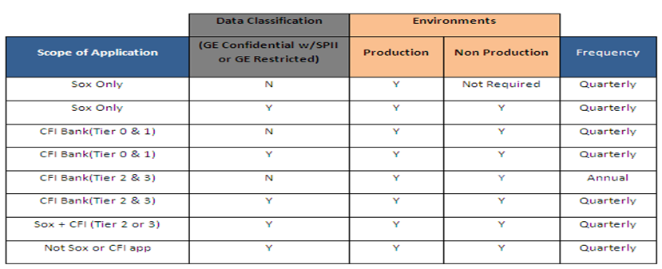
System Access Test (SAT)
SAT Scoping Matrix:
Apps that are Sox and CFI Tier 2/3 and with no SPII/Restricted data will have to provide DS5.4.16 control deliverable quarterly.

Slide 43

Questions & Discussion Forum

Slide 44
